Slide 1
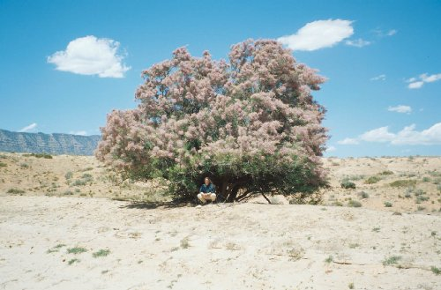
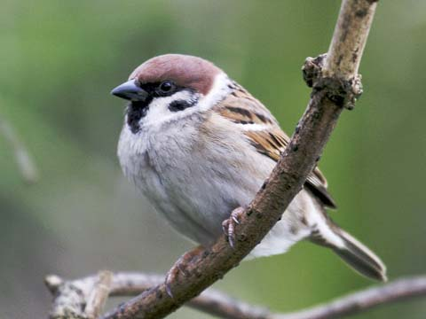
Habitat Suitability Models
Goal: find the suitable habitat for a species
Also called “Species Distribution Models”
  Ecological Niche Modeling (ENM)
Tamarisk, NIISS.org
Tree Sparrow, Herts Bird Club

Slide 2
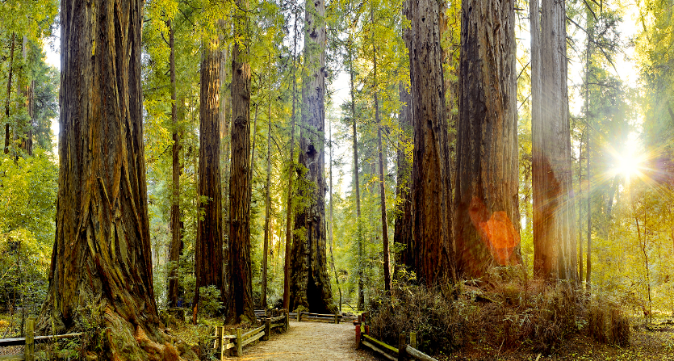
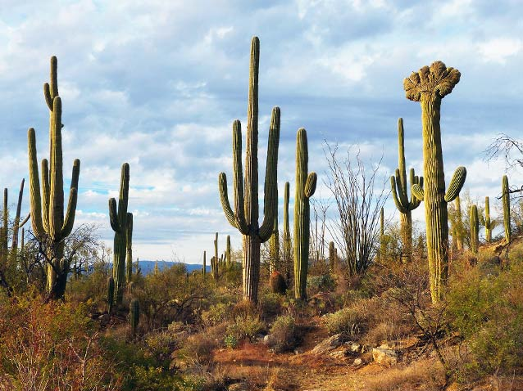
Species Are Adapted to Particular Habitats
US National Park Service

Slide 3
Predicting Habitat Suitability
Predicting potential species distributions at large spatial and temporal extents
Given:
  Limited data
    Most have unknown uncertainty
    Most biased/not randomly sampled
    >90% just “occurrences” or “observations”
  Lots of species
  Climate change and other scenarios

Slide 4
Methods
Density, Abundance:
  Continuous response
  Linear Reg., GLM, GAMs, BRTs
Presence/Absence:
  logit/logistic
  What does absence mean?
Presence-Only (occurrences)
  What to regress against?

Slide 5
Presence Only
Need to have something to regress against
Obtain background points or pseudo-absences
  Sample a portion or all of the sample area
  Regress the density of presences vs. the density of the sample area in the environmental space
Regress density of presence against density of predictor values
Jeff Dunk: Point-process problem

Slide 6
From the Theory of
Biogeography
+
0
-
Salinity
Environmental Space
Population Growth
Niche
+
0
-
Salinity
Temperature
Temperature
Brown, J.H., Lomolino, M.V. 1998, Biogeography: Second Edition. Sinauer Associates, Sinauer Massachusetts
Notes:
Temperature is based on enzyme reactions

Slide 7
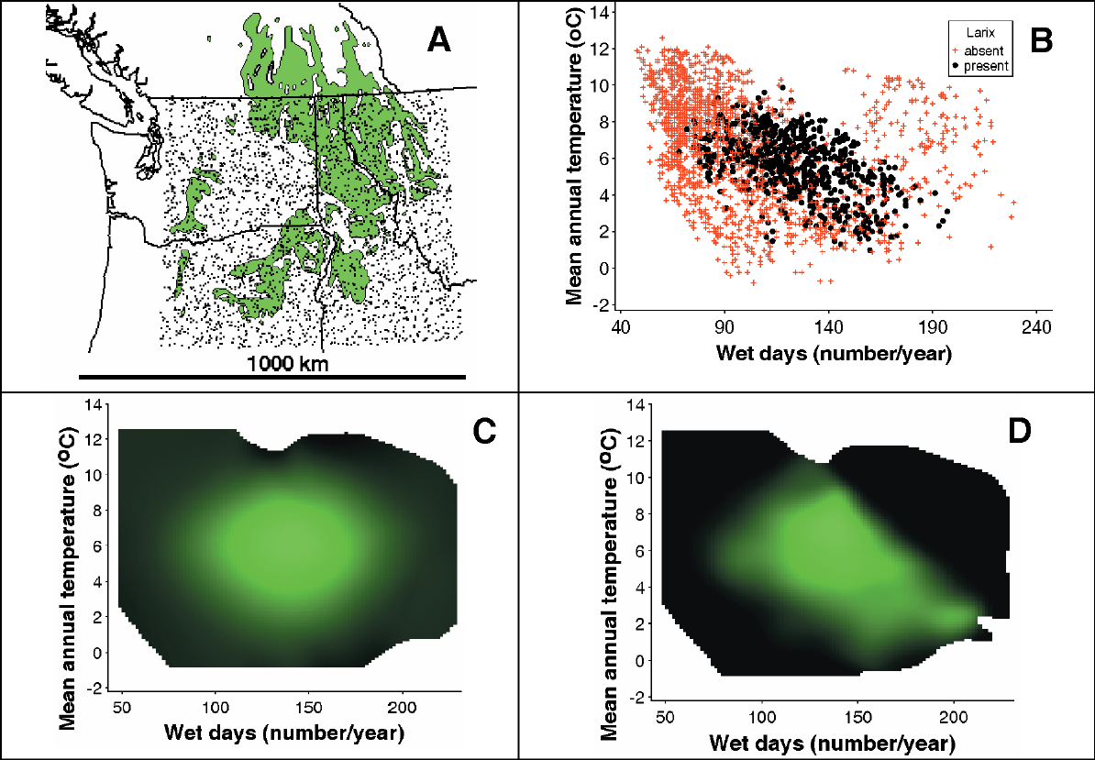
GAM
NPMR
2006, MccCune, Non-parametric habitat models with automatic interactions
Notes:
Fig. 2. A. Distribution of Larix occidentalis (green) in western North America and points used in the random sample. B. 2D slice
through the predictor space; Larix was present at solid points (black), absent at + (red). C. Response surface from two-predictor
GAM; gradient from black to green indicates likelihood of occurrence, with the greenest shade indicating the most favorable habitat.
D. Response surface from two-predictor NPMR model. E. Estimated probability of occurrence of L. occidentalis superimposed on
distribution map (black lines show range; gray lines are state boundaries). Deeper green indicates a higher probability of occurrence.
Blue ellipses indicate areas where L. occidentalis is absent but potentially present, based on recent climate.

Slide 8
HSMs Are Powerful Tools
Can predict potential habitat for species under changing environmental conditions
  Climate, pollution, water, human impacts
Because HSMs are based on environmental data, they do not predict a species distribution. However, they are also called Species Distribution Models (SDMs)

Slide 9
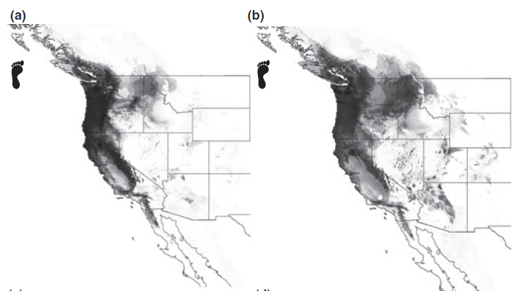
Predicted Distribution of Bigfoot
(a) for the present climate and (b) under a possible climate change
scenario involving a doubling of atmospheric CO2 levels
- Lozier, Predicting the distribution of Sasquatch in western North America: anything goes with ecological niche modelling

Slide 10
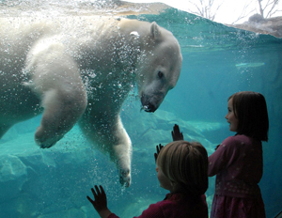

HSM Issues
clizen.org
Human-Modified
Environments
Isolated
Areas
North Island, Seychelles PHOTO: AUSTEN JOHNSTON

Slide 11
Early Methods
BioClim
BioMapper
Genetic Algorithm for Rule Set Production (GARP)
Generalized Linear Models (GLM)
Generalized Additive Models (GAMs)
Kernel Methods
Neural Networks

Slide 12
Latest Methods
Multivariate adaptive regression splines (MARS)
MaxEnt – piece-wise regression with Maximum Entropy optimization
Hyper-Envelope Modeling Interface (HEMI 2), Bezier curves
Non-Parametric Multiplicative Regression (NPMR)

Slide 13
Tree Methods
Regression Trees
Boosted Regression Trees
Random Forests

Slide 14
Two Overall Approaches
Occurrence/Presence
Mechanistic
Occurrences
“Greenhouse” experiments
Correlate
Design
Model
Model
Generate
Predictor
Layers
Generate
Map

Slide 15
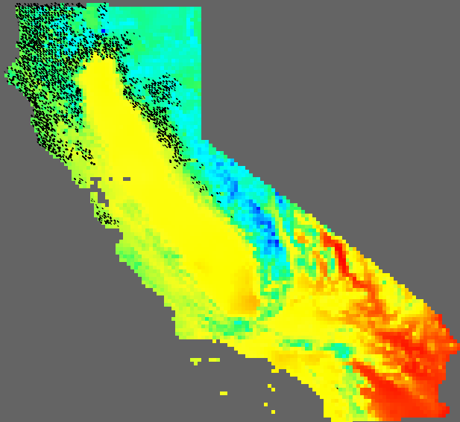
Doug-Fir vs. Temperature
Low
Temp
High
Temp

Slide 16
Doug-Fir vs. Temperature
Relative Density of Occurrences
Mean Annual Temperature in degrees C * 10
Green: histogram of environmental variable values, Red: histogram of occurrences

Slide 17
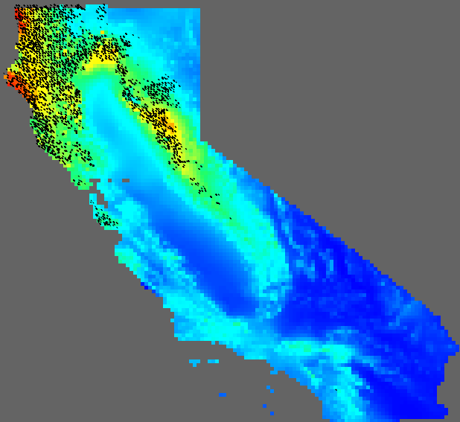
Doug-Fir vs. Precipitation
High
Precip
Low
Precip

Slide 18
Doug-Fir vs. Precipitation
Relative Density of Occurrences
Annual Precipitation in Millimeters
Green: histogram of environmental variable values, Red: histogram of occurrences

Slide 19
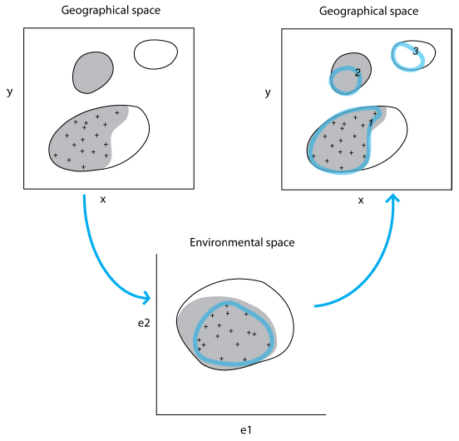

Geographical Space
Observed Occurrences
Realized Niche/Distribution
Fundamental Niche/Distribution
Environmental Space
Model Fitted to Occurrences
Adapted from Richard Pearson, Center for Biodiversity and Conservation at the American Museum of Natural History
Notes:
- Julia showed temp and percip as axis for LTER sites

Slide 20
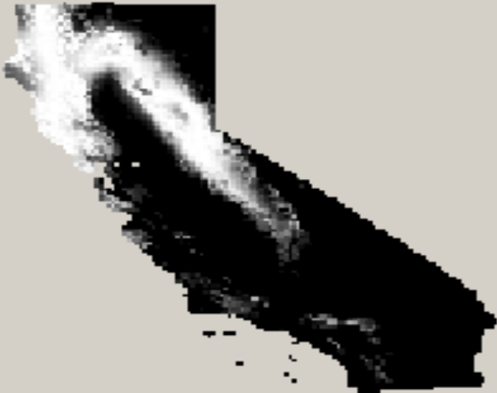
“Good” Model
Douglas-Fir Model with Just
Annual Precipitation

Slide 21
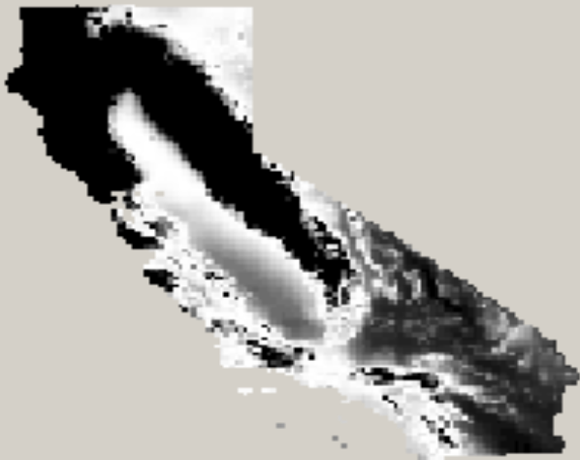
“Poor” Model
Douglas-Fir Model with Just
Annual Precipitation

Slide 22
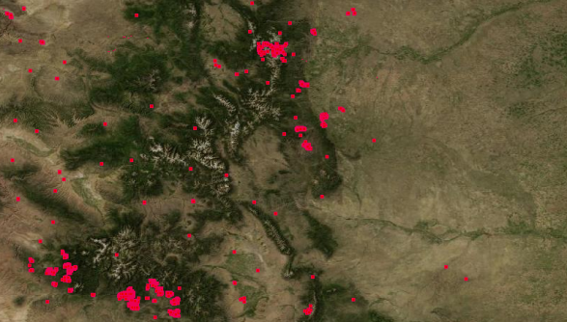
Modeling Process
Spreadsheets
Occurrences
Lat | Lon | Temp | Precip
-105.504 | 40.35819 | 5.32 | 58.4
-107.472 | 40.498 | 6.31 | 47.6
Environmental Layers
Temperature
Precipitation
Modeling
Algorithm
Habitat Suitability Map
Model Parameters
100
Variable | Coefficient | P-Value
Intercept | -1.52 | 0.064
Annual Precip | -0.05 | 0.0
Annual Temp. | 0.61 | 0.0
0
Map
Generation

Slide 23
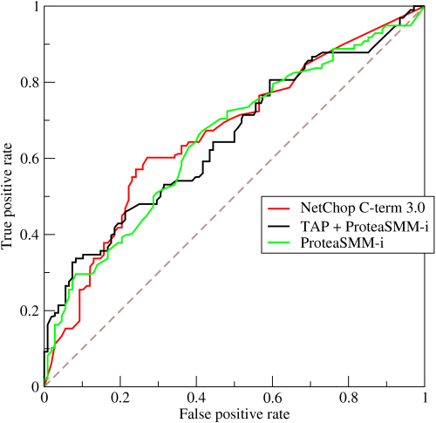
ROC Curve
Receiver operating characteristic (ROC)
See:
  Wikipedia
Notes:
AIC was not initially used because there was no analytic solution for Likelihood.

Slide 24
Area Under the Curve (AUC)
Area under an ROC curve
Popular for HSM
Encourages over-fitting

Slide 25
AUC
Advantages
  Provides comparable range:
    0.5 – random
    1 – perfect model
  Easy to compute
Disadvantages
  Does not include number of parameters so encourages over fitting
  Increasing the study area increases the AUC value

Slide 26
AIC
Can now be computed for HSMs with ENMTools, Presence/Absence library for R, or BlueSpray
Is this the “best” measure?

Slide 27
Uncertainty in Data
Experts more accurate in correctly identifying species than volunteers
  88% vs. 72%
  Volunteers: 28% false negative identifications and 1% false positive identifications
  Experts: 12% false negative identifications and <1% false positive identifications
Conspicuous vs. Inconspicuous
  Volunteers correctly identified “easy” species 82% of the time vs. 65% for “difficult” species
  62% of false ids for GB were CB
Notes:
Buckthorn species were merged for this and similar analyses because comfort level was identified to the genus level only.

Slide 28
Correcting for Environmental Variability
The previous examples assume a uniform distribution of environmental variation (i.e. same area for each value).
Dividing the number of occurrences by the relative area for each environmental variable value corrects for this.

Slide 29
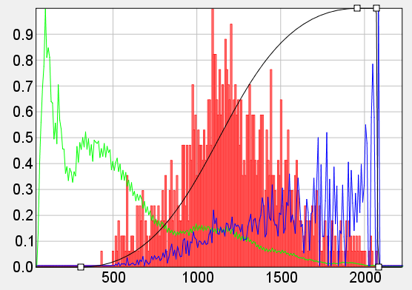
Doug-Fir vs. Precipitation
Relative Density of Occurrences
Annual Precipitation in Millimeters
Green: histogram of environmental variable values, Red: histogram of occurrences,
Blue: Red / Green

Slide 30
Doug-Fir vs. Temperature
Relative Density of Occurrences
Annual Temperature in degrees C * 10
Green: histogram of environmental variable values, Red: histogram of occurrences,
Blue: Red / Green

Slide 31
Spatial Modeling Concerns
Over fitting the data
  Are we modeling biological/ecological theory?
What does the model look like?
  In environmental space vs. geographic space
Absence points?
  What do they mean?
Analysis and representation of uncertainty?
Can we really model the potential distribution of a species from a sub-sample?
Notes:
What do they mean?
We did not find the species there at some point in time
Was it there before?
Was it removed?
Has it been able to get there?
We should plant it and see what happens!
Pseudo-random points?

Slide 32
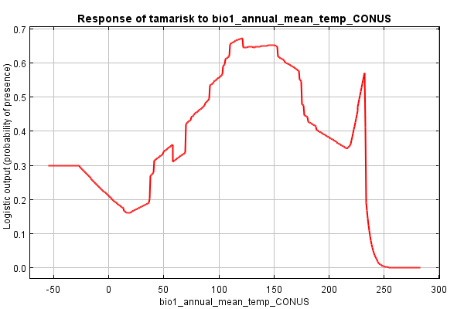
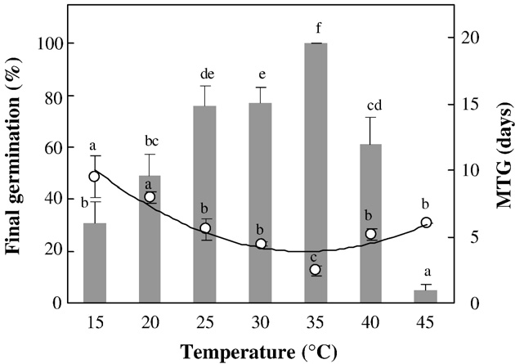
Over-fitting The Data?
Maxent model for Tamarix in the US: response to temperature when modeled with temperature and precipitation
What should the
model look like?
Maraghni, M., M. Gorai, and M. Neffati. 2010. Seed germination at different temperatures and water stress levels, and seedling emergence from different depths of Ziziphus lotus. South African Journal of Botany 76:453-459.
Notes:
Ran tamarix model with Maxent
Regularization parameter to improve over fitting
Challenges with current approaches are predicting outside the same area, models are not well behaved outside the sampled environmental space

Slide 33
Maxent Model Parameters
bio12_annual_percip_CONUS, -4.946359908378759, 52.0, 3269.0
bio1_annual_mean_temp_CONUS, 0.0, -27.0, 255.0
bio1_annual_mean_temp_CONUS^2, -0.268525818823649, 0.0, 65025.0
bio12_annual_percip_CONUS*bio1_annual_mean_temp_CONUS, 7.996877654196997, -15579.0, 364506.0
(681.5<bio12_annual_percip_CONUS), -0.27425992202014554, 0.0, 1.0
(760.5<bio12_annual_percip_CONUS), -0.0936978541445044, 0.0, 1.0
(764.5<bio12_annual_percip_CONUS), -0.34195651409710226, 0.0, 1.0
(663.5<bio12_annual_percip_CONUS), -0.002670474531339423, 0.0, 1.0
(654.5<bio12_annual_percip_CONUS), -0.06854638847398926, 0.0, 1.0
(789.5<bio12_annual_percip_CONUS), -0.1911885535421742, 0.0, 1.0
(415.5<bio12_annual_percip_CONUS), -0.03324755386105751, 0.0, 1.0
(811.5<bio12_annual_percip_CONUS), -0.5796722427924351, 0.0, 1.0
(69.5<bio1_annual_mean_temp_CONUS), 0.35186971641045406, 0.0, 1.0
(433.5<bio12_annual_percip_CONUS), -0.4931182020218725, 0.0, 1.0
(933.5<bio12_annual_percip_CONUS), -0.6964667980858589, 0.0, 1.0
(87.5<bio1_annual_mean_temp_CONUS), 0.026976617714580643, 0.0, 1.0
(41.5<bio1_annual_mean_temp_CONUS), 0.16829480000216024, 0.0, 1.0
(177.5<bio1_annual_mean_temp_CONUS), -0.10871555671575972, 0.0, 1.0
(91.5<bio1_annual_mean_temp_CONUS), 0.146912383178006, 0.0, 1.0
(1034.5<bio12_annual_percip_CONUS), -2.6396398836001156, 0.0, 1.0
(319.5<bio12_annual_percip_CONUS), -0.061284542503119606, 0.0, 1.0
(175.5<bio1_annual_mean_temp_CONUS), -0.2618197321200044, 0.0, 1.0
(233.5<bio1_annual_mean_temp_CONUS), -0.9238257709966757, 0.0, 1.0
(37.5<bio1_annual_mean_temp_CONUS), 0.3765193693625046, 0.0, 1.0
(103.5<bio1_annual_mean_temp_CONUS), 0.09930300882047771, 0.0, 1.0
(301.5<bio12_annual_percip_CONUS), -0.1180307164256701, 0.0, 1.0
(173.5<bio1_annual_mean_temp_CONUS), -0.10021086459501297, 0.0, 1.0
(866.5<bio12_annual_percip_CONUS), -0.26959719615289196, 0.0, 1.0
(180.5<bio1_annual_mean_temp_CONUS), -0.04867293241613234, 0.0, 1.0
(393.5<bio12_annual_percip_CONUS), -0.11059348100482837, 0.0, 1.0
(159.5<bio1_annual_mean_temp_CONUS), -0.017616972634255934, 0.0, 1.0
(36.5<bio1_annual_mean_temp_CONUS), 0.060674971087442194, 0.0, 1.0
(188.5<bio1_annual_mean_temp_CONUS), -0.03354825843486451, 0.0, 1.0
(105.5<bio1_annual_mean_temp_CONUS), 0.06125114176950926, 0.0, 1.0
(153.5<bio1_annual_mean_temp_CONUS), -0.12297221415244217, 0.0, 1.0
(1001.5<bio12_annual_percip_CONUS), -0.45251593589861716, 0.0, 1.0
(74.5<bio1_annual_mean_temp_CONUS), 0.026393316564235686, 0.0, 1.0
(109.5<bio1_annual_mean_temp_CONUS), 0.14526936669793344, 0.0, 1.0
(105.0<bio12_annual_percip_CONUS), -0.42488171108453276, 0.0, 1.0
(25.5<bio1_annual_mean_temp_CONUS), 0.003117221628224885, 0.0, 1.0
(60.5<bio12_annual_percip_CONUS), 0.5069564460069241, 0.0, 1.0
(231.5<bio12_annual_percip_CONUS), -0.08870602107253492, 0.0, 1.0
(58.5<bio1_annual_mean_temp_CONUS), -0.23241170568516853, 0.0, 1.0
(49.5<bio1_annual_mean_temp_CONUS), 0.026096163653731276, 0.0, 1.0
(845.5<bio12_annual_percip_CONUS), -0.24789751889995176, 0.0, 1.0
'bio1_annual_mean_temp_CONUS, -6.9884695411343865, 232.5, 255.0
(320.5<bio12_annual_percip_CONUS), -0.10845844949785532, 0.0, 1.0
(121.5<bio1_annual_mean_temp_CONUS), -0.12078290084760739, 0.0, 1.0
(643.5<bio12_annual_percip_CONUS), -0.18583722923085083, 0.0, 1.0
(232.5<bio1_annual_mean_temp_CONUS), -0.49532279859757916, 0.0, 1.0
(77.5<bio12_annual_percip_CONUS), 0.09971599046855084, 0.0, 1.0
(130.5<bio1_annual_mean_temp_CONUS), -0.01184619743061956, 0.0, 1.0
(981.5<bio12_annual_percip_CONUS), -0.29393286794072015, 0.0, 1.0
`bio12_annual_percip_CONUS, 0.023135559662549977, 52.0, 147.5
'bio1_annual_mean_temp_CONUS, 1.0069995641400011, 216.5, 255.0
`bio1_annual_mean_temp_CONUS, 0.9362466512437257, -27.0, 16.5
(397.5<bio12_annual_percip_CONUS), -0.02296169875555788, 0.0, 1.0
`bio12_annual_percip_CONUS, 0.14294702222037983, 52.0, 251.5
(174.5<bio1_annual_mean_temp_CONUS), -0.01232159395283821, 0.0, 1.0
'bio1_annual_mean_temp_CONUS, -1.011329703865716, 150.5, 255.0
`bio12_annual_percip_CONUS, 0.12595056977305263, 52.0, 326.5
'bio1_annual_mean_temp_CONUS, -0.6476124017711095, 119.5, 255.0
'bio1_annual_mean_temp_CONUS, 1.737841121141096, 219.5, 255.0
(90.5<bio1_annual_mean_temp_CONUS), 0.012061755141948361, 0.0, 1.0
`bio12_annual_percip_CONUS, 0.1002190195916142, 52.0, 329.5
`bio12_annual_percip_CONUS, 0.3321425790853447, 52.0, 146.5
`bio12_annual_percip_CONUS, -0.3041756531549861, 52.0, 59.0
(385.5<bio12_annual_percip_CONUS), -0.0014858371668052357, 0.0, 1.0
(645.5<bio12_annual_percip_CONUS), -0.02553082983087001, 0.0, 1.0
'bio12_annual_percip_CONUS, -4.091264412509243, 532.5, 3269.0
`bio1_annual_mean_temp_CONUS, -0.35523981011398936, -27.0, 111.5
`bio1_annual_mean_temp_CONUS, -0.21070138315106224, -27.0, 112.5
`bio1_annual_mean_temp_CONUS, 0.22680342516229093, -27.0, 18.5
(13.5<bio1_annual_mean_temp_CONUS), -0.04258692136695379, 0.0, 1.0
`bio1_annual_mean_temp_CONUS, 0.12827234634968193, -27.0, 19.5
linearPredictorNormalizer, 2.2050375426546283
densityNormalizer, 1311.2581836276431
numBackgroundPoints, 10000
entropy, 8.358957722359722
162 Parameters
Maxent model from Tamarix model of western US using precipitation and temperature.

Slide 34
Document Caveats
Assumptions
  No errors in the data collection, handling, processing
  No software defects
  Occurrences represent viable populations in the wild
  Density of occurrences correlates with potential habitat
Uncertainties
  Field data, environmental layers
  256x256 grid used for 2d histograms

Slide 35
Some Caveats
We are modeling “observations”
  Modeling occurrences with some uncertainty
  Modeling the realized niche if the data is a complete sample for the environmental space the species currently occupies
  Modeling the fundamental niche if B is true and the species is covering it’s full possible range of habitats
Habitat Suitability Modeling
  Predicting the potential species distribution
Notes:
Are we modeling the species or the incidence of the species and birders?
Define realized niche and fundamental niche

Slide 36
Migration Animations
Jim’s web site
  http://tinyurl.com/6krghts
Gray whale model
  http://tinyurl.com/4xtmzho
Barn swallows

Slide 37
Oregon Marine Planning Data
Scientific and Technical Advisory Committee (STAC) Review
Materials:
  http://oregonocean.info/index.php?option=com_content&view=article&id=480:stac-review-of-oregon-marine-planning-data&catid=15:stay-up-to-date-on-ocean-alternative-energy&Itemid=12

Slide 38
Additional Slides

Slide 39
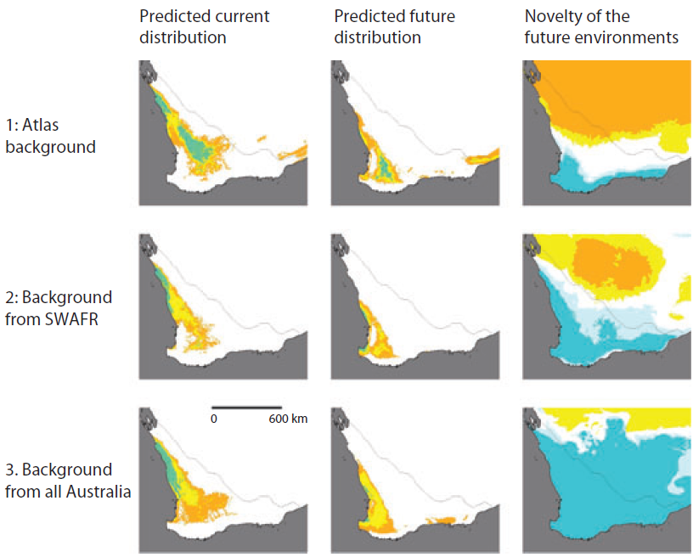

Slide 40
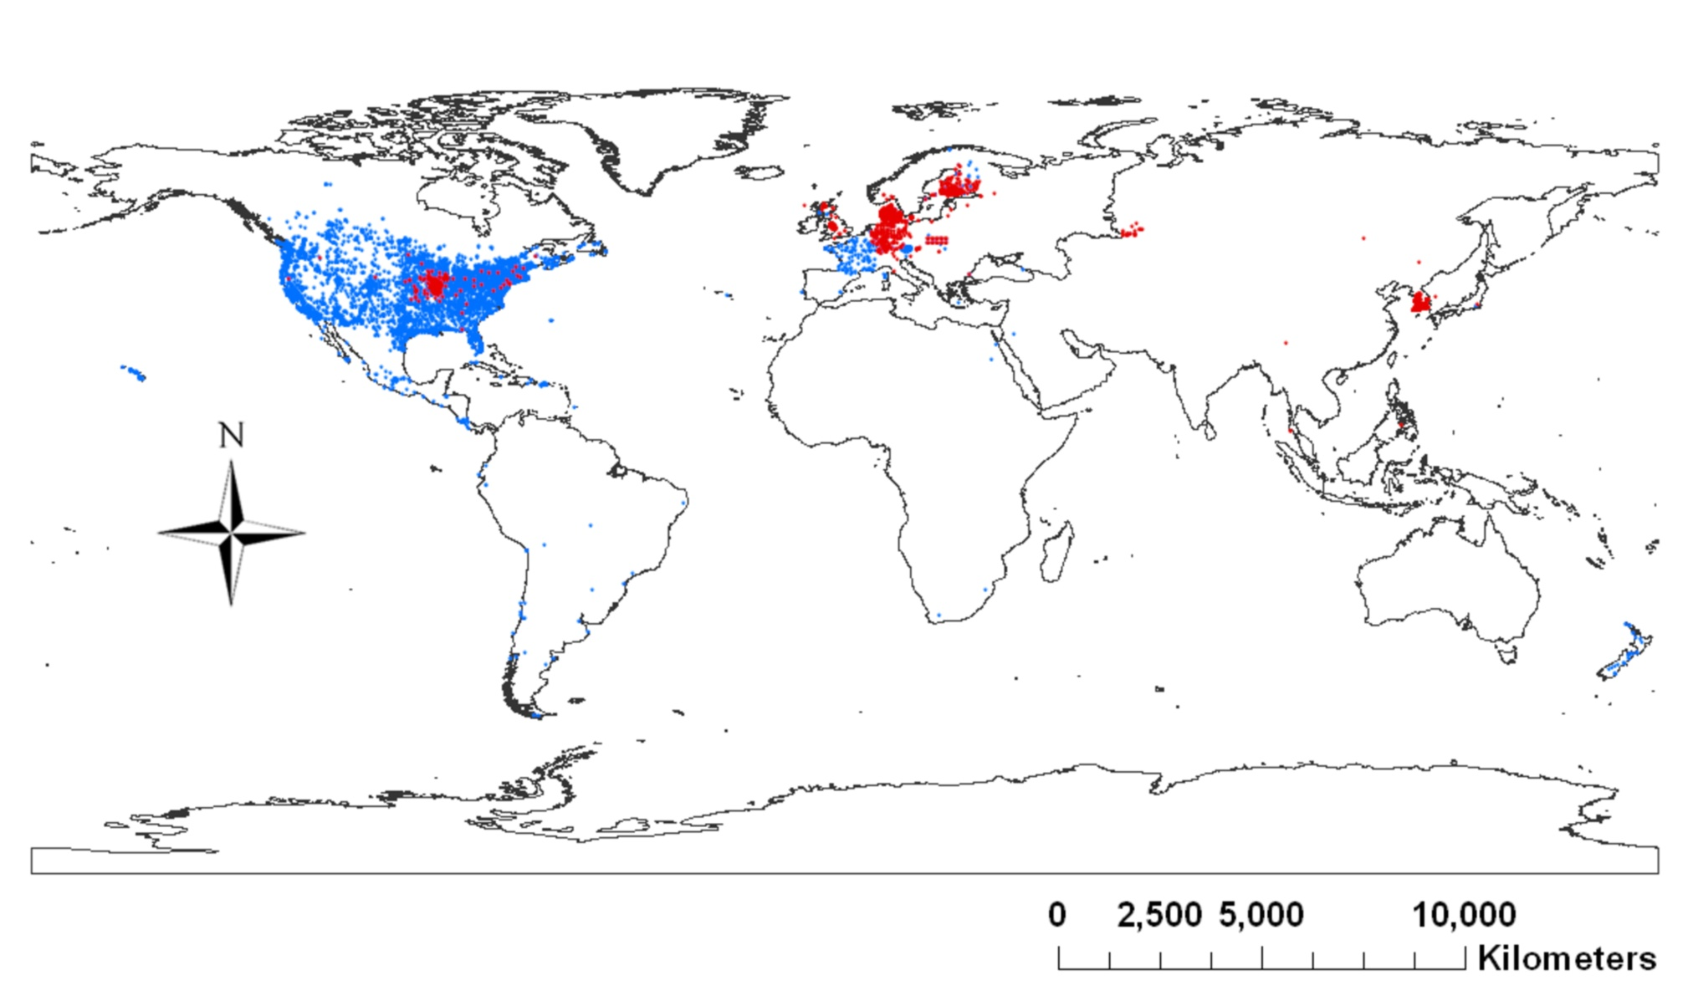
Tree Sparrow Occurrences
House Sparrows
Eurasian Tree Sparrows
Graham, J., C. Jarnevich, N. Young, G. Newman, T. Stohlgren, How will climate change affect the potential distribution of Eurasian Tree Sparrows (Passer montanus)? Current Zoology, 2011.

Slide 41
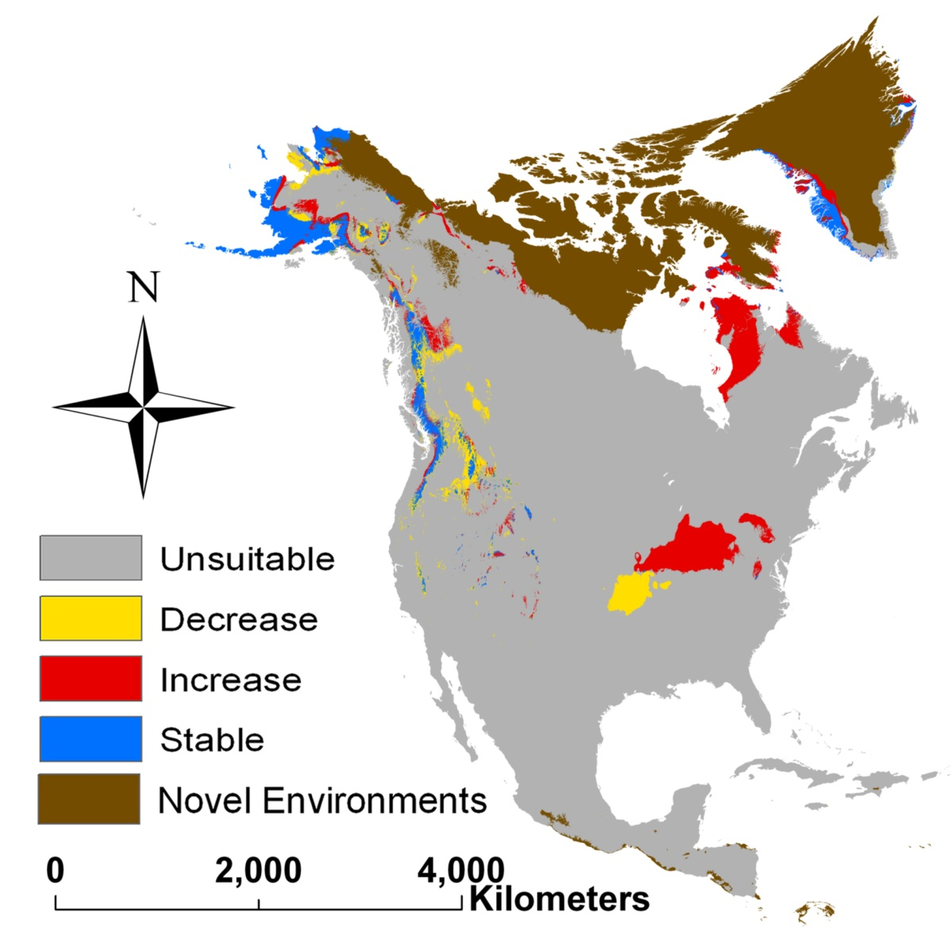
Tree Sparrow Model - 2050
Graham, J., C. Jarnevich, N. Young, G. Newman, T. Stohlgren, How will climate change affect the potential distribution of Eurasian Tree Sparrows (Passer montanus)? Current Zoology, 2011
Notes:
- The best models today are small in extent and use species with lots of data

Slide 42
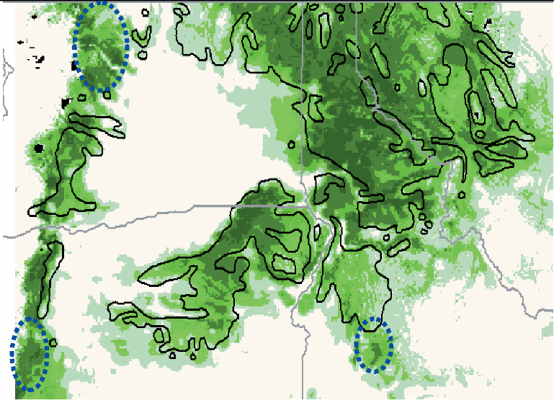
Western Larch in NA
2006, MccCune, Non-parametric habitat models with automatic interactions
Notes:
Western larch in the Northeastern area of the US

Slide 43
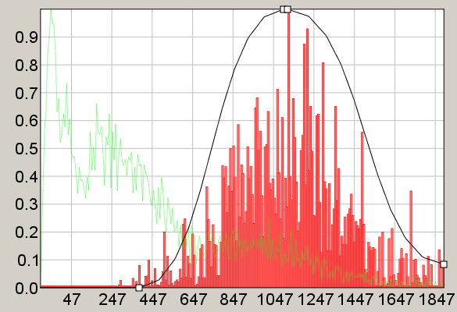
Doug-Fir vs. Precipitation
Douglas-Fir vs. Annual Precipitation

Slide 44
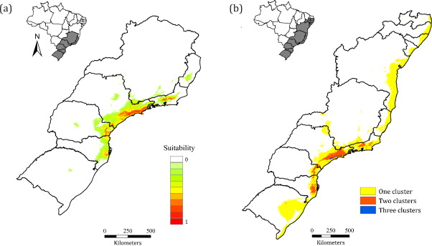
Montane Frogs in Rainforest
2013, Marcio et al., Understanding the mechanisms underlying the distribution of microendemic
montane frogs (Brachycephalus spp., Terrarana: Brachycephalidae) in the
Brazilian Atlantic Rainforest (a. all records, b. combined with other models)
Notes:
Uses MaxEnt

